Slide 1

RoboTour
A robot that improves your experience in museums
Notes:
Finn
For those who wasn’t here in the last RoboTour. RoboTour is a multi-purpose assistive robot tailored to museum visitors. Our mission is to provide a dynamic cultural experience for museum visitors by providing guiding assistance in multiple languages.

Slide 2
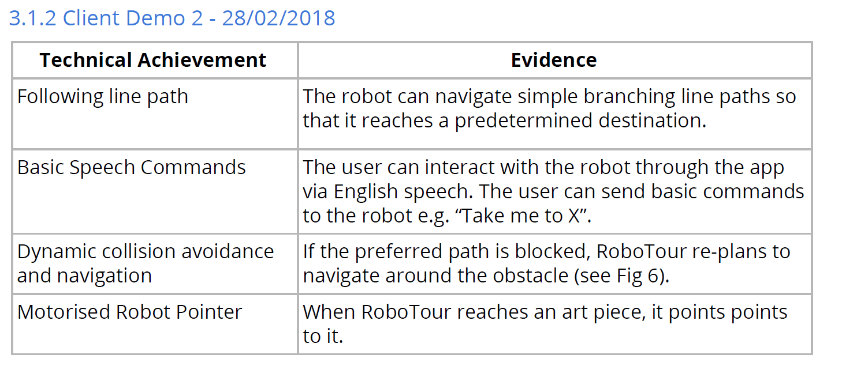
What we have achieved
Fig 1: Milestones for client demo 2
Notes:
Finn: We have achieved our 4 key milestones for this demo. Line following, Speech Commands, Dynamic collision avoidance and Motor Pointer. We have brought all these 4 features together and will be demonstrated later on the live demo. Devidas will talk about the line following.

Slide 3
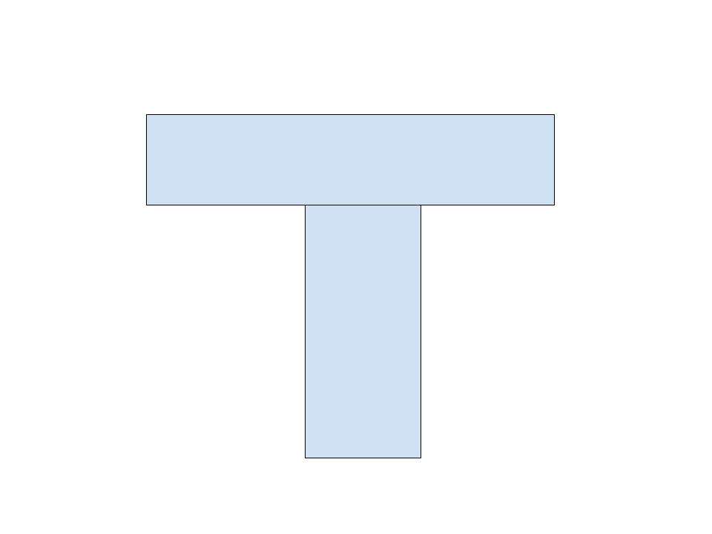
Following line path
The robot can navigate simple branching line paths so that it reaches a predetermined destination.
Branching point
Fig 2: Typical branch
Notes:
The robot uses 2 lego sensors to reliably follow the white line. To be more precise, only the right sensor is actually following the line and the left one is only waiting for a branch. That way the robot detects when it needs to turn or keep moving forward. The motors use PID controller to interpret sensor readings and move accordingly. One sensor just for line following turned out to be enough, but we have also tried incorporating custom light sensors to give better understanding where the line is. And now Michal will take us through the enhancements we’ve made to the sensing package.

Slide 4
Custom sensor suite - Motivation
Limited sensing capabilities (4 sensor ports)
Need to track line reliably, including intersections
Complex environment - robust obstacle avoidance
Relatively low polling rate - 10Hz
Notes:
As the essential feature of our robot is to navigate the space effectively, we need to ensure it has the necessary information to do so.
Our starting point - EV3 system - has relatively limited sensing capabilities - the number of sensors is limited to 4, which is a low number. Our focus is on reliable line following as a means of getting where we want to and obstacle avoidance - as a means of not getting where we don’t want to. It is important as the robot has to operate in an environment with humans, so it cannot be dangerous, yet it has to be active and helpful. The last advantage is that we can increase the polling rate (LEGO sensors run at approx 10Hz) so that we can run our control loop more frequently.

Slide 5
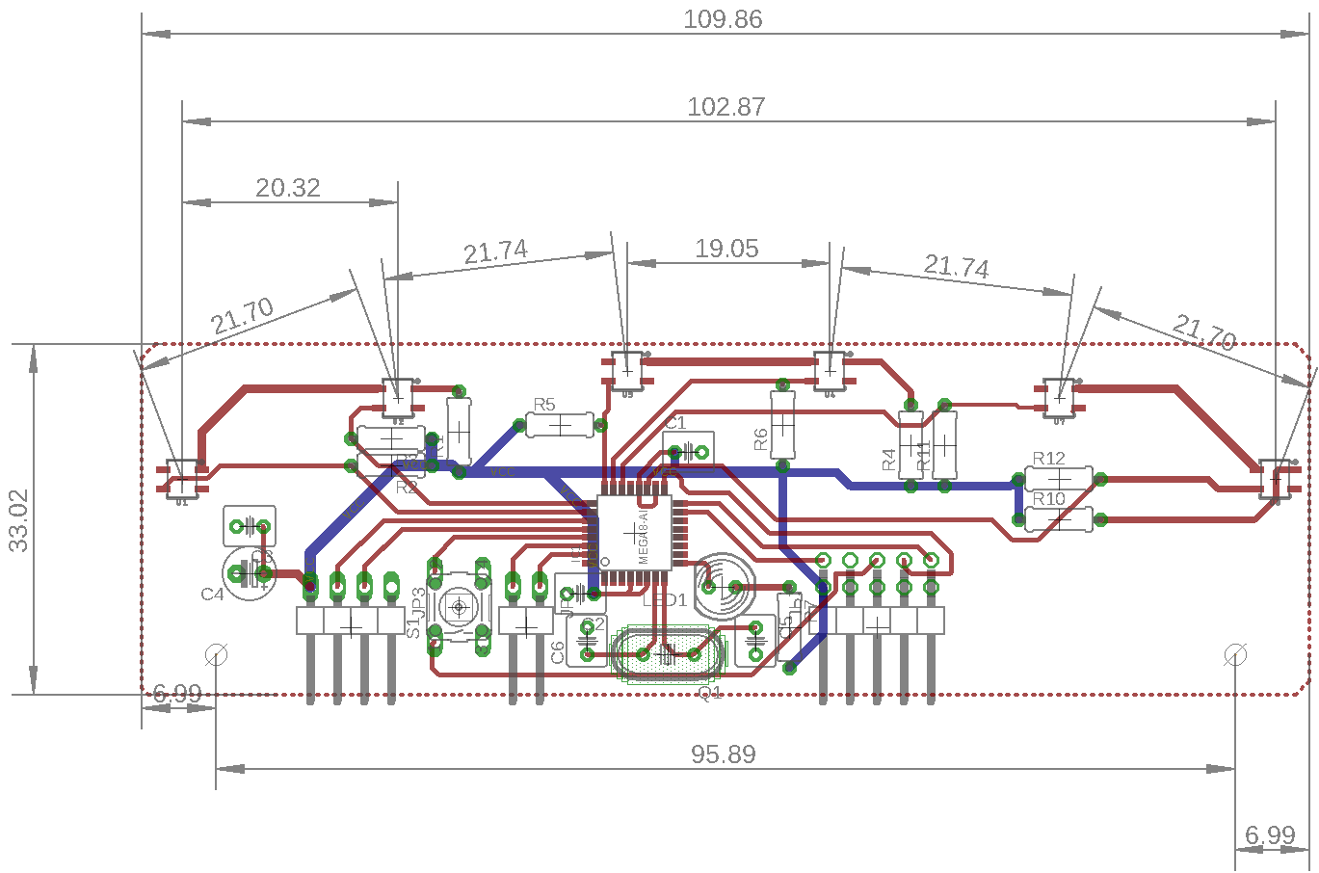
Custom sensor suite - Design
Fig 4: Design
Notes:
The sensor is relatively simple. 6 opto reflective transducers (our main sensing elements) are accompanied by a microcontroller that takes care of digitising the readings for further processing. The placement of the sensors ensures that the line position can be uniquely determined.

Slide 6
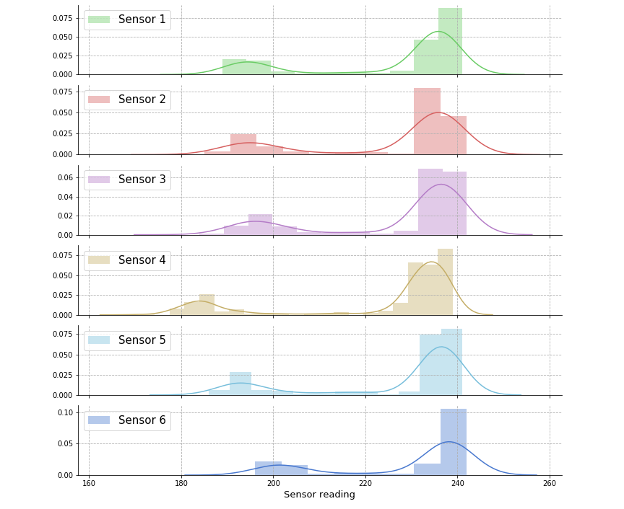
Custom sensor suite - Results
Fig 6: Sensor readings histogram
Notes:
The sensor was assembled and the graph shows the results of the tests. The sensor was mounted at a fixed distance above the ground and moved around the line. We can clearly see the bimodal distribution indicating useful information to be extracted. The right peaks correspond to the floor, whereas the left correspond to the line. Our focus next is to increase the separation between the readings to remove ambiguities (note that the histogram range is only from 100 to 250, roughly half of the theoretical range).

Slide 7
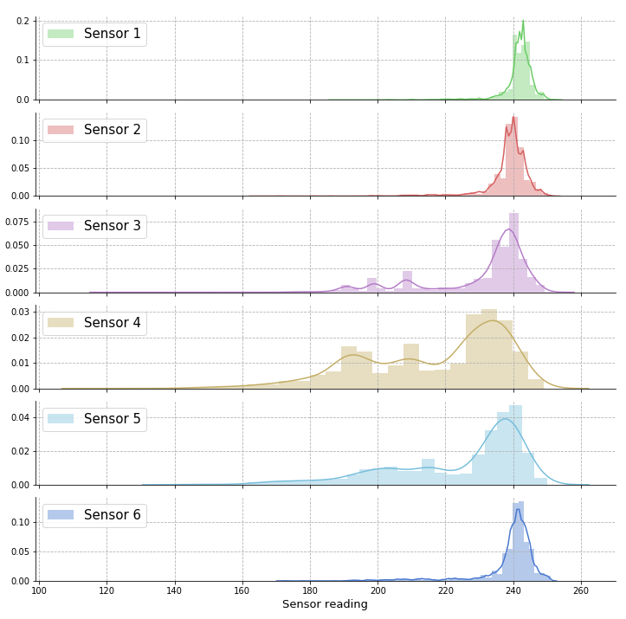
Custom sensor suite - Results
Fig 7: Line following histogram
Notes:
Similar graph - histogram showing readings obtained while the robot was following the line. It is clear that the central sensors were often floating over the edge of the line, hence the intermediate values. Increased separation should solve this issue.

Slide 8
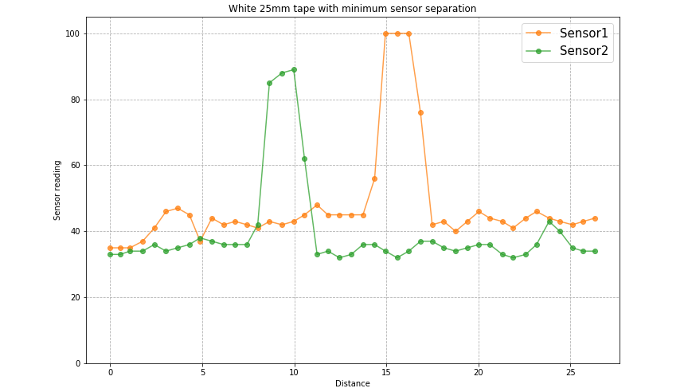
Custom sensor suite - Results
Fig 5: LEGO sensor pass over the line
Notes:
Last part is the coverage and resolution. This graph shows the reference point of the LEGO sensors setup.
Sensor reading on the y axis, distance travelled on the x. Only two sensors, hard to infer the line’s relative position

Slide 9
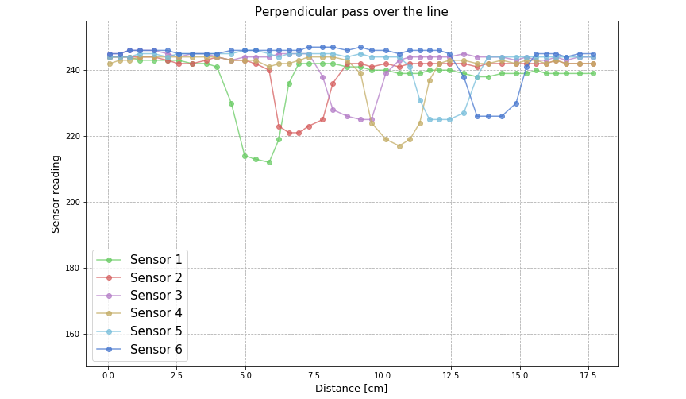
Custom sensor suite - Results
Fig 5: Custom sensor pass over the line
Notes:
Analogous graph for our custom sensor. The line can be traced precisely throughout the entire pass. Higher refresh rate allows to capture more intermediate values, increasing resolution. The use of many sensors allow for better branch detection and range extrapolation. As soon as we incorporate it into our line-following, the performance should increase.

Slide 10
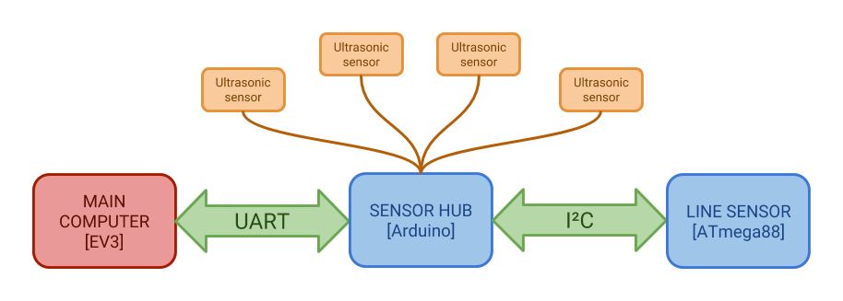
Custom sensor suite - Architecture
Fig 8: Sensing subsystem architecture
Notes:
A quick glimpse on the architecture of the sensing system. We use an Arduino as an intermediate between the Linesensor and the main processor as well as a hub for ultrasonic distance sensors. That wraps up our robotic side and i shall now pass over to Mahbub, who will take us through the speech user interface.

Slide 11
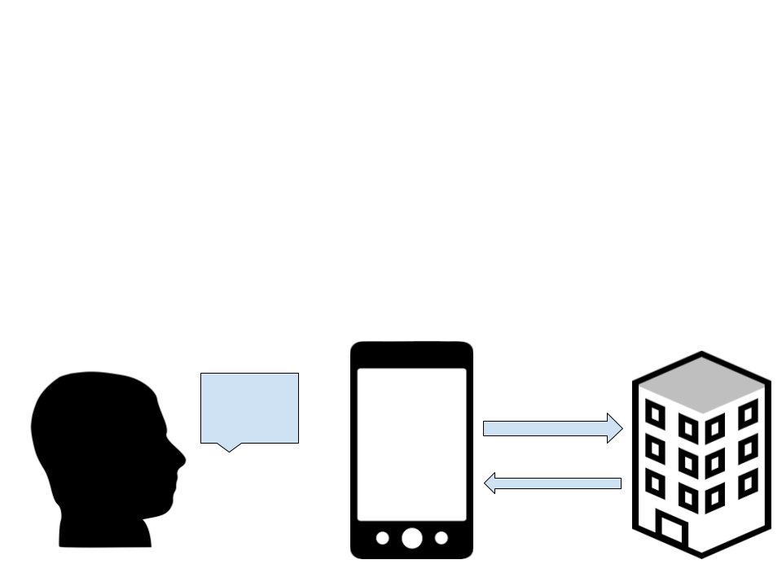
Basic Speech Commands
The user can interact with the robot through the app via speech.
e.g. “Take me to the Mona Lisa”.
Additional feature added:
Allowing users to search by text
Speech processing works with all supported languages
Fig 9: Interaction
Notes:
Google translate works asynchronously
Only used in non English translations
Google translate loaded asynchronously not to block the UI thread, points of speech to phone then translating speech
Two possible points of failure, from ambiguities between what you say and what the phone hears and what the phone thinks it heard and the google translation api translating the text.

Slide 12
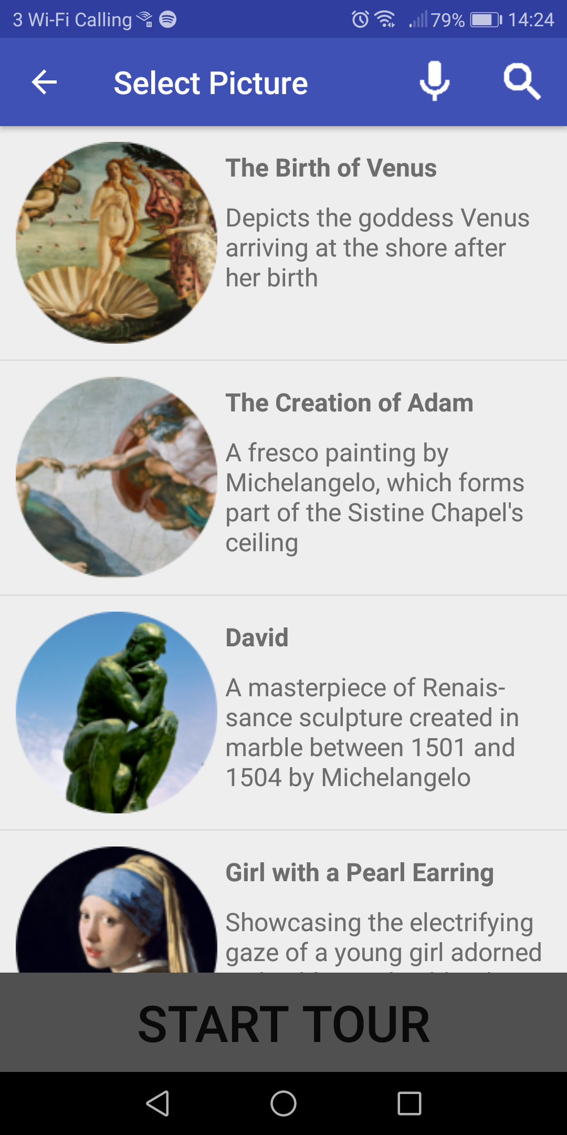
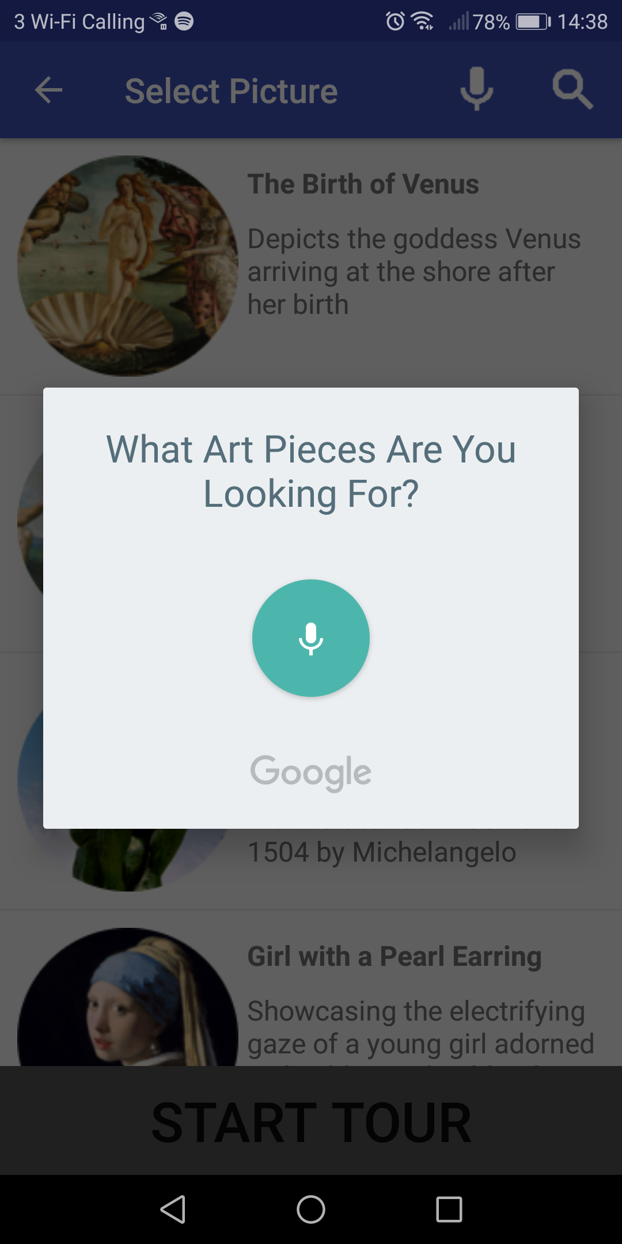
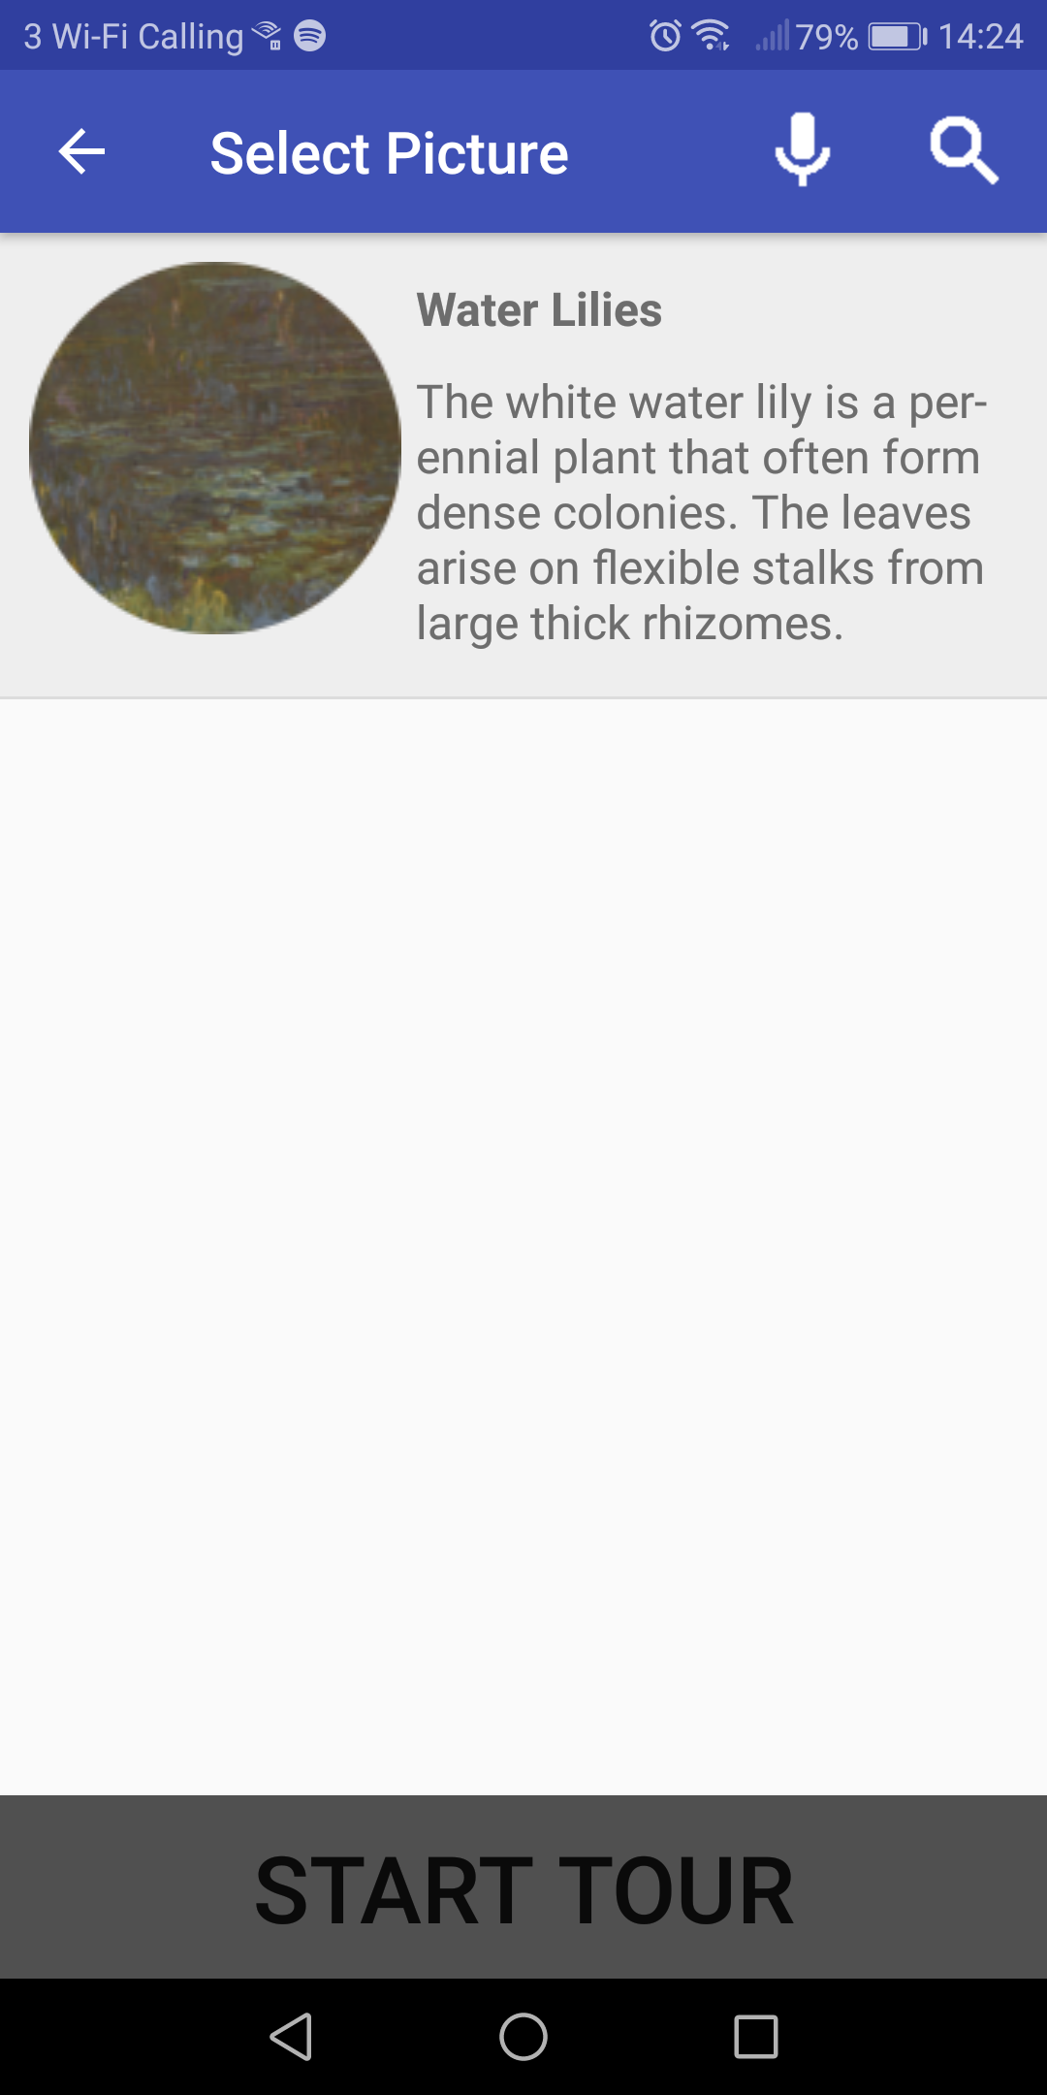
Basic Speech Example - English
User says “Take me to Water Lilies”
Google Speech API hears the following possible results:
[take me to water lilies, take me to Waterloo East, take me to Waterloo lease, took me to water lilies, take me to water lillies]
Fig 10: User interface of speech selection in English
Notes:
Illustrate with 3
Here you can see
BP1
BP2
Then for each art piece
So to illustrate how the speech works we’re going to go over 3 quick examples:
Here you can see an example of the speech working in English. The user wishes to go to Water Lilies and so says “Take me to Water Lilies”.
All the top results that the google API thinks the user said are displayed here *point to bp2*
Then for each art piece we check if either the art piece’s name or artist is a substring of any of the top results from the API, and if so it is displayed so that the user can confirm that they do in fact want to go to the displayed art pieces.
Questions:
Why no direct command?
A: We want the user to confirm

Slide 13
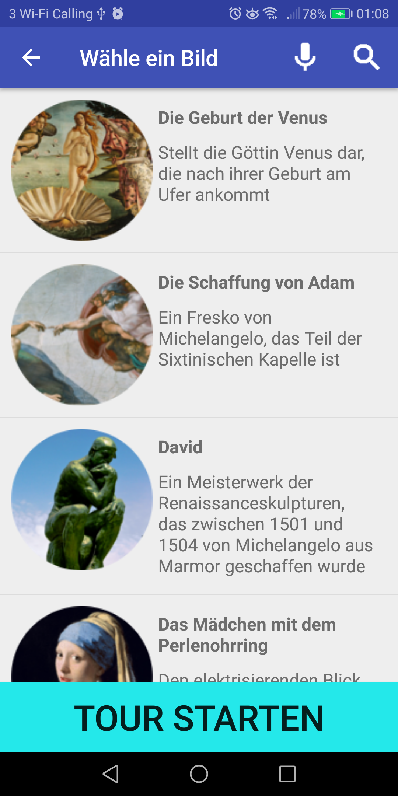
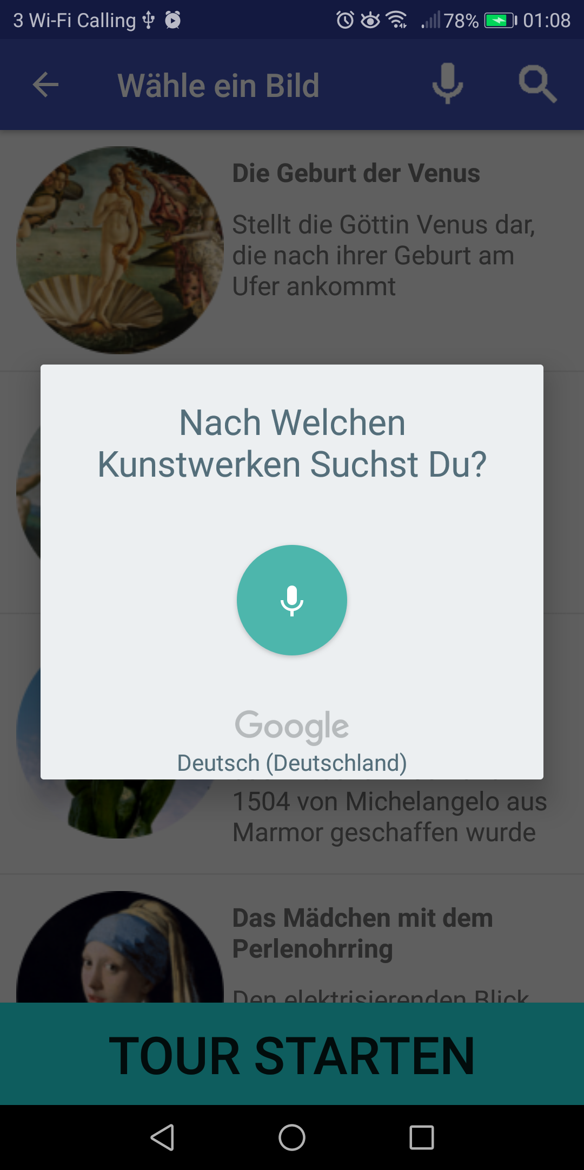
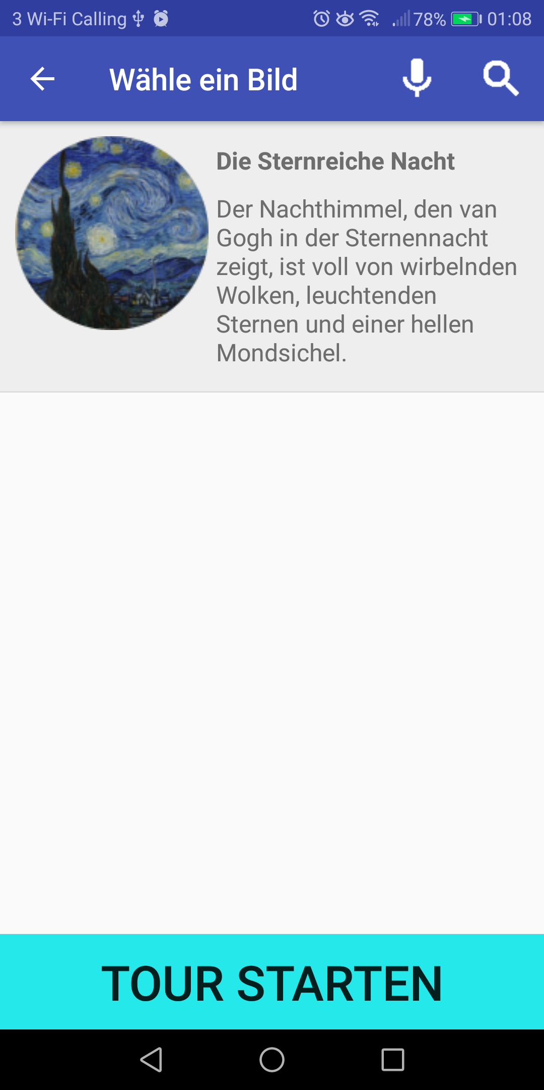
Basic Speech Example - German
User says “Wo ist die Sternreiche Nacht?”
Google Speech API hears the following possible results:
[wo ist die Sternzeichen 8, wo ist die sternzeichen 8, wo ist die Sternzeichen acht, wo ist die Stern reiche Nacht, wo ist die Stirn reichen 8]
Google Translate API translates the results to the following:
[where is the zodiac 8, where is the zodiac 8, where is the zodiac eight, where is the star rich night, where is the star rich 8]
Fig 11: User interface of speech selection in German
Notes:
Other non-english languages are similar
Same first 2 points
Translate
Compound words => adjusted matching algorithm, excluding insig
The non-english languages work similarly, but with some key differences.
In German they call “The Starry Night” - “Die Sternreiche Nacht”
When you say “Wo ist die Sternreiche Nacht”, meaning “Where is the Starry Night” the following possible results are displayed *point to bp2*
Each result is then translated. *point to bp3* As you can see none of these results are “the starry night” because the Google Speech API didn’t write sternreiche as a compound word but as 2 seperate words.
Therefore we adjusted the matching algorithm so that if any words match (excluding insignificant words such as “of”, “the”, or “with”) we get a match.
Question
Why didn’t you use the same matching algorithm for English and German
A: With the non-english languages you are technically more prone to getting false positives although we didn’t find this to be the case with our examples. Also, the english matching algorithm is technically faster.
Question
Why did you translate to English
A: In Chinese we needed to translate to English because we found it to be more reliable and less confusing to translate to english and then pattern match then to pattern match the characters. And in the languages that are more like English we translated because it would be easier to understand and debug because I for instance speak no spanish and could get confused and because getting rid of insignificant words is easier to just stick to english. For example, if we did it directly for german we would have to set insignificant words as “der, die, das, mit and oder”, there are 3 words for the in german and I only know that because I speak german so I think you can see why we decided to translate.

Slide 14
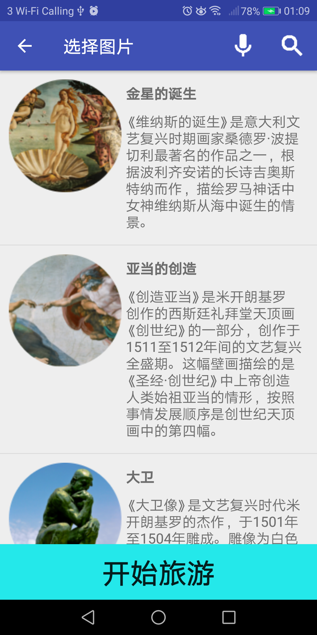
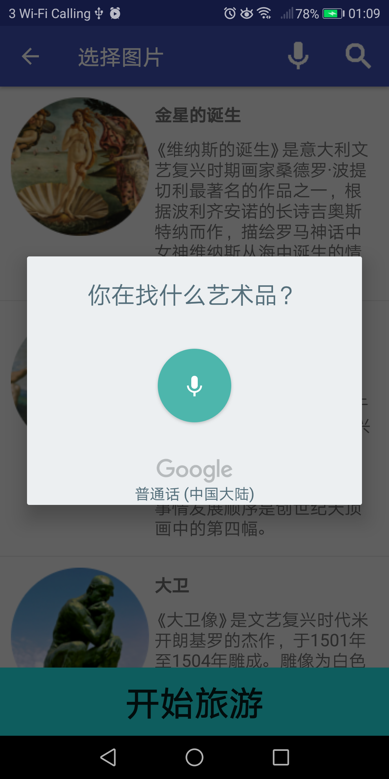
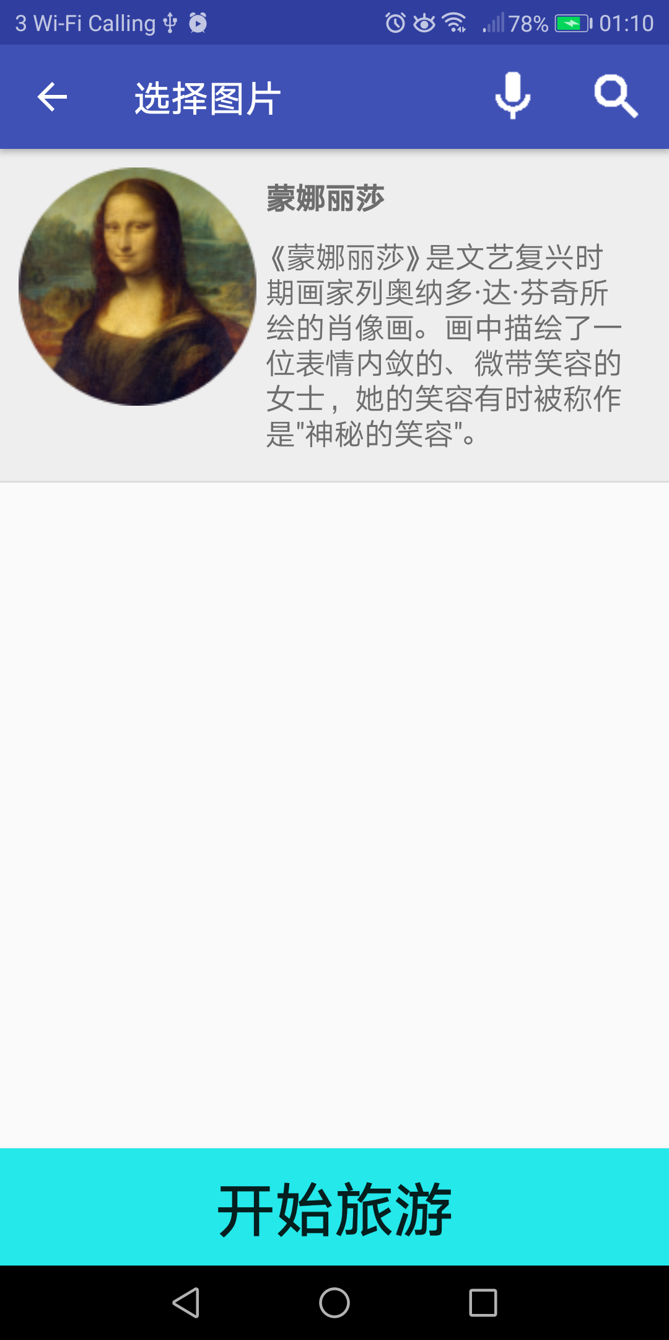
Basic Speech Example - Chinese
User says “带我去蒙娜丽莎”
(Dài wǒ qù méng nà lì shā)
Google Speech API hears the following possible results:
[带我去蒙那里沙, 带我去蒙娜丽莎, 带我去蒙那丽莎, 带我去蒙那里山]
Google Translate API translates the results to the following:
[Take me to Mona Lisa, Take me to the Mona Lisa, Take me to Mona Lisa, Take me to Montana]
Fig 12: User interface of speech selection in Chinese
Notes:
And here’s another example with the user speaking chinese. The users speech is written as chinese characters *bp2* and these characters are translated to english *bp3* and word matching is applied to display the Mona Lisa *image 3*

Slide 15
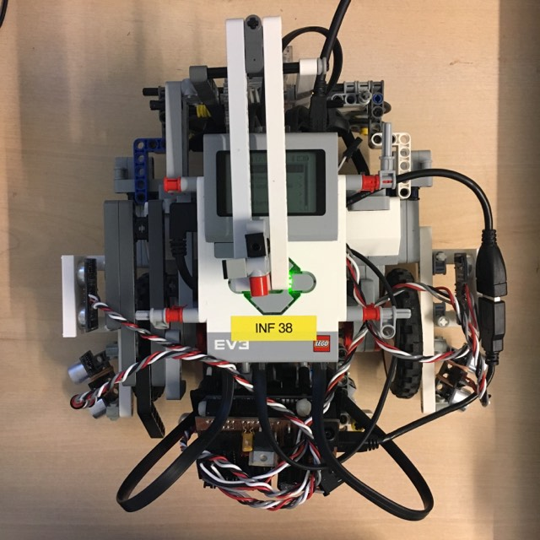
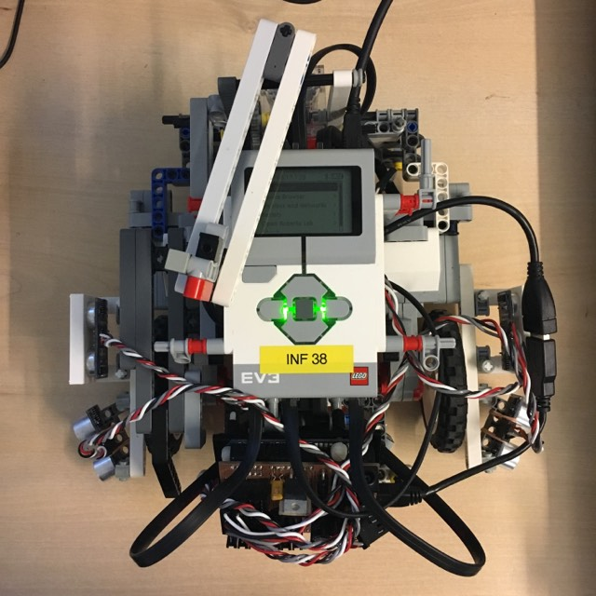
Motorised Robot Pointer
Fig 13: Pointer position at the beginning
Fig 14: Pointer position after 50 turns
Notes:
Reaches, stops, points, says, returns tour continues
Hardware not perfect. 2 pictures show deviations. Considered gyro
When RoboTour reaches an art piece it will stop and the pointer will point to the art piece, RoboTour will then say “Here is <the painting>”. Then the pointer will resume its default position and the tour continues.
We found that the hardware we have available isn’t perfect. As can be seen by the 2 pictures the pointer does go off after a lot of turns. This is how much the pointer deviated after 50 turns. We considered using the EV3 gyrocope but we found the gyro is only correct within 10 degrees and there is a delay for each reading so we just decided to go without it.
Questions
How does it work?
We just set the motor to turn a certain amount, and then we changed those parameters until the pointer rotated 90 degrees every time. We found that the hardware we have available isn’t perfect and we considered using the gyro but the gyro is only correct within 7 degrees and there is a delay between the readings so we just decided to go without it. We found even with the limited hardware the pointer didn’t deviate by a noticeable amount even after 100 turns.
(Please don’t delete this)
Action Points:
Insert 2 / 3 images
Test 100 turns
Implementation changes:
Add speech upon arrival?
User must press Start?

Slide 16
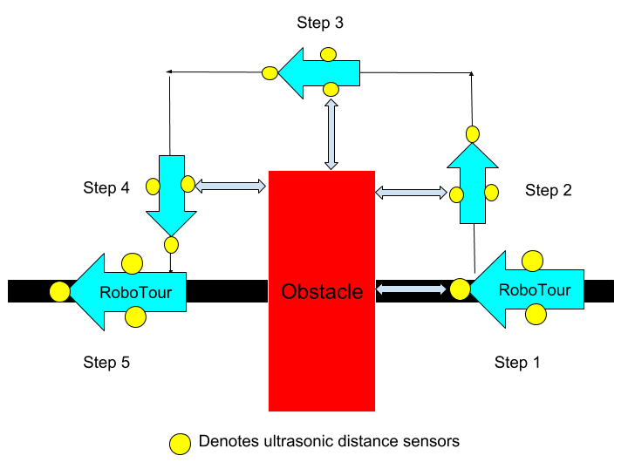
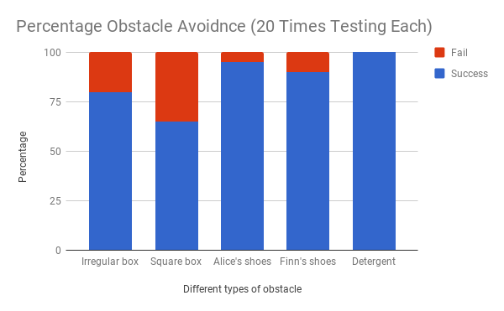
Dynamic collision avoidance and navigation
Fig 15: Obstacle avoidance method outlined in project plan.
Fig 16: Obstacle avoidance testing stacked column chart
Notes:
Alice :)
In the last demo we mentioned that we had a problem with the robot not stopping immediately. We’ve solved this by changing the braking method from passive to active and so now the robot stops almost immediately.
This is the obstacle avoidance method we mentioned in the project plan, but we found that it doesn’t work so well in practice. So we came up with a solution that works much better. The robot travels around the object in an arc keeping a constant distance throughout the navigation process. We’ll be able to show this in more detail during the live demonstration.
The obstacle avoidance is not perfect. We have tested 5 different types of obstacle, 20 times each. And as you can see in the graph, it fails most with rectangular obstacles, while it succeeds almost every time with the non-rectangular obstacles. We believe this is because it’s hard for the robot to detect the sharp edges using the ultrasonic sensor.
We’ve also tried to solve some edge cases.
For instance, if there’s a wall in the way
Or if the branch is blocked so that the robot doesn’t know it has passed a branch
But so far we haven’t been able to reliably solve these edge cases but we hope to do so before the final demo.
Now we will show you how the robot actually works.

Slide 17
Live Demonstration
Notes:
Live demo of the robot using the pointer, navigating branches and line following and basic speech commands.

Slide 18
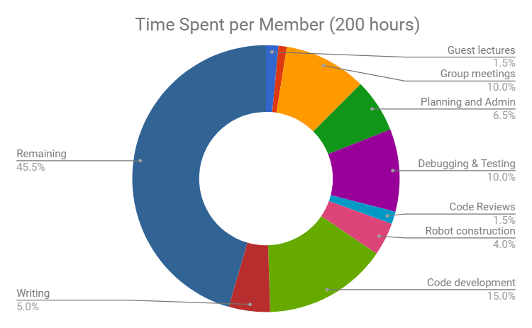
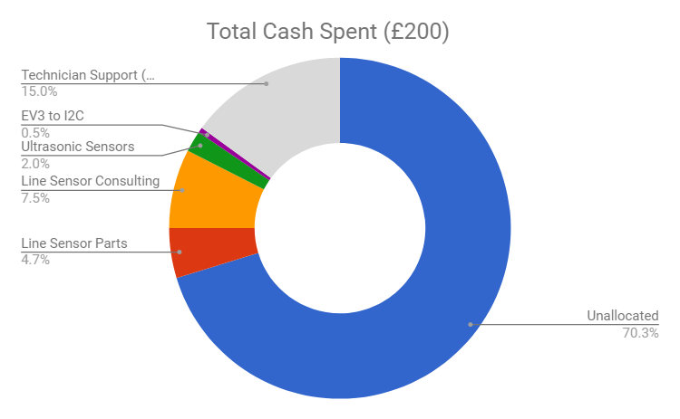
Resources/Member
Fig 17: Time spent pie chart
Fig 18: Budget pie chart
Notes:
Main:
Conclusion: We are on schedule to completing tasks because it took us 110 hours/member of work each to get to this point

Slide 19
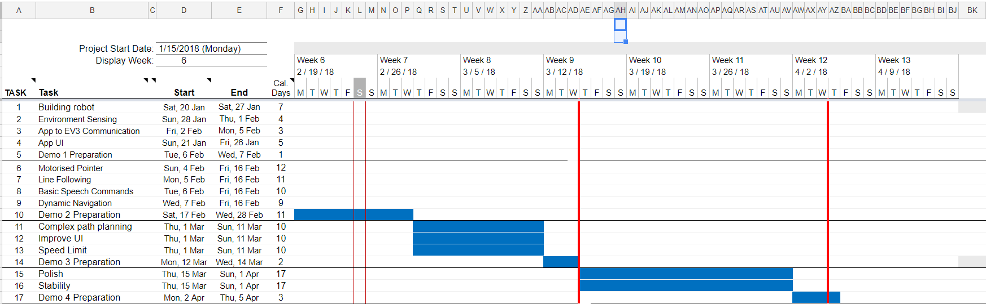
Plans Going Forward - Gantt Chart
Fig 19: Gantt chart
Notes:
Gantt chart not changed
We just need to be careful with it due to allowing Michal to do further work on the line sensor and as Mariyanna is still not back

Slide 20
Plans Going Forward - Next Demo
3.1.3 Client Demo 3 - 14/03/2018
Technical Achievement | Evidence
Speed Adjustment / Variable Speed | The robot is able to adjust the speed to the users’ requirements. Additionally, the robot stops if the connection drops or upon the the users request.
Improved User Interface | Allows the user to ask the robot for recommendations via text or speech. There will be a script of acceptable speech commands.
Complex Path Planning | The robot considers multiple paths between selected points and selects the one that minimises travel time.
Fig 20: Milestones for next client demo
Notes:
Here we have what we plan to have completed for Demo 3.
Address the 3 points
The only difference with this is like Michal said we are building a custom line sensor for this demo.

Slide 21
Thank You
We would like to welcome any questions or suggestions that you may have.
Notes:
Thank for listening
Ask for questions or suggestion
Invite to try the product

